Slide 1
EQUIPMENT

Slide 2
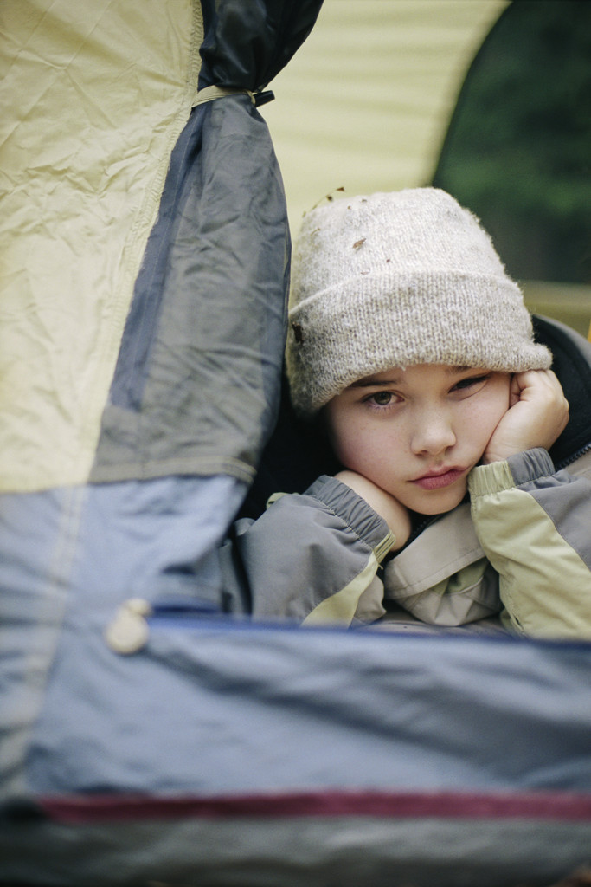
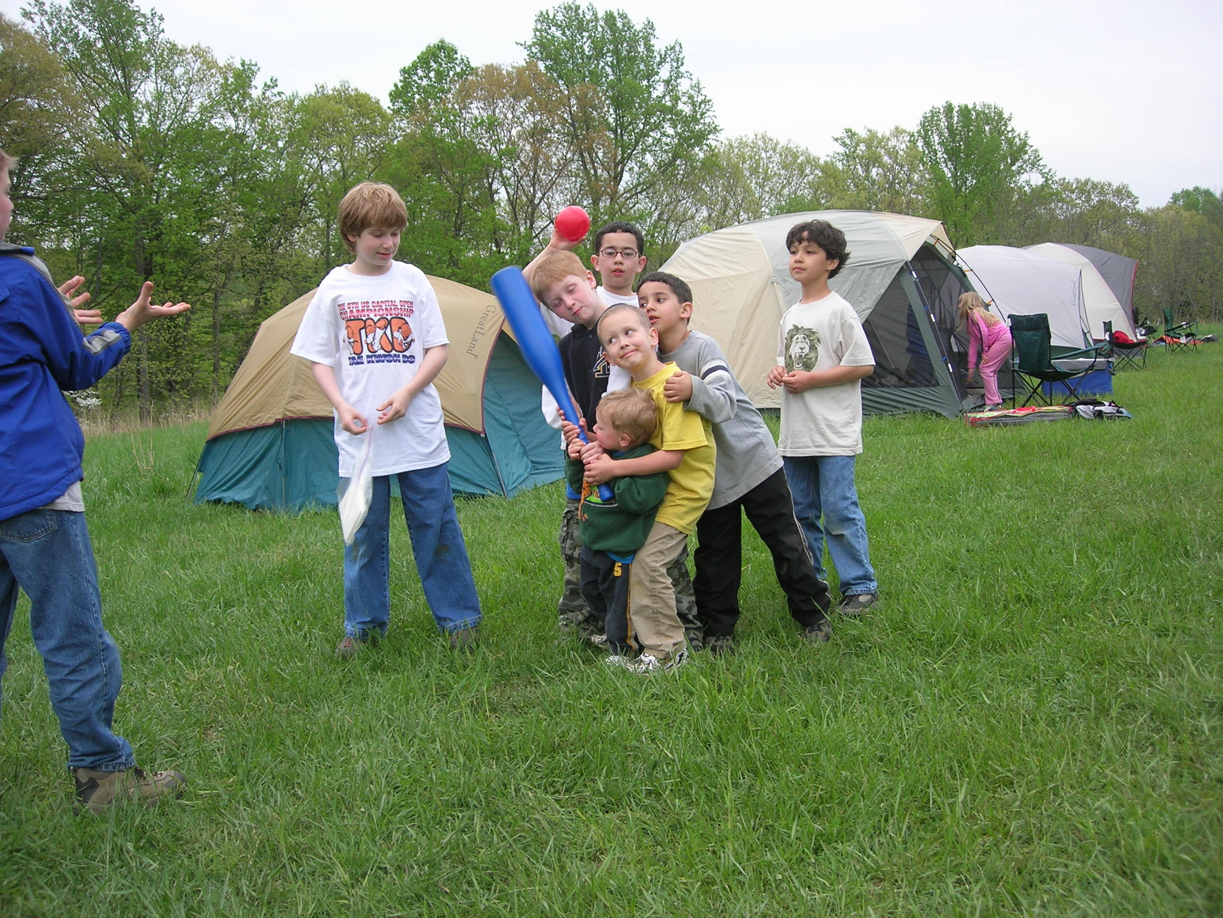
Successful First-Time Camping Experience

Slide 3
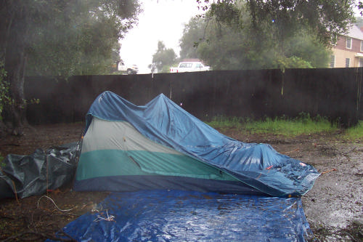
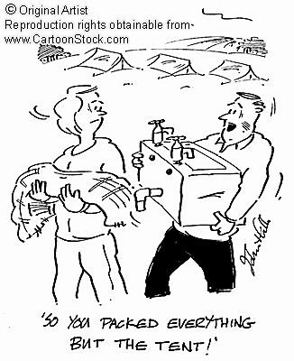
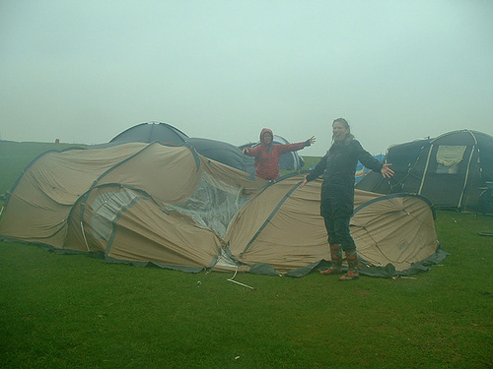
Bad Experience

Slide 4
Learning Objectives
Cub Scout Outdoor Essentials List
Types of Sleeping Bags
Types of Tents
How to select a good campsite
Equipment needed for individual and group camping

Slide 5
Cub Scout Outdoor Essentials List
First Aid Kit
Water Bottle
Flashlight
Trail Food
Sunscreen
Whistle

Slide 6
Cub Scout First Aid Kit
A Few Band-Aids
Some Antiseptic Wipes
Antibiotic cream

Slide 7
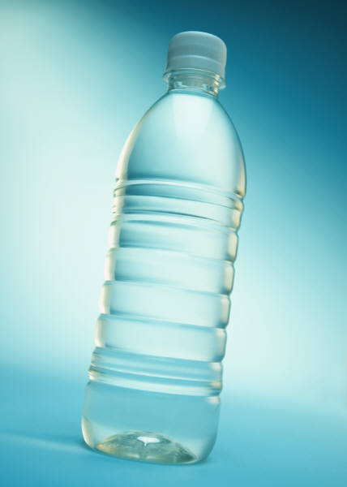

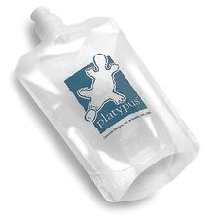
Water Bottle

Slide 8
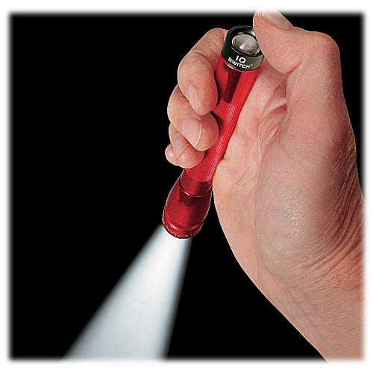
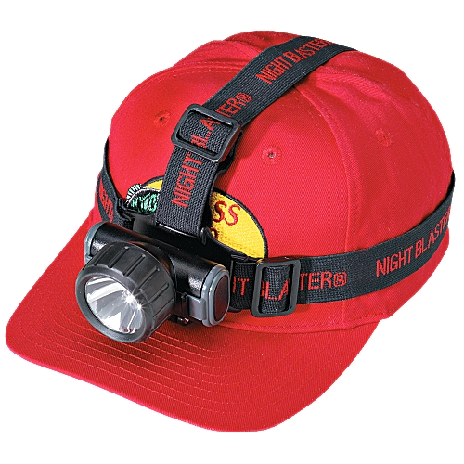
Flashlight

Slide 9
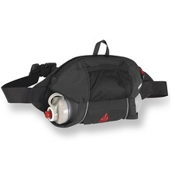
Trail Food/ Trail Mix
Sunscreen (SPF 15 or greater)
Whistle

Slide 10
Cub Scout Outdoor Essentials List
Sleeping Bags
Tents
Ground Cloths
Pads and Mattresses

Slide 11
How Do Sleeping Bags Work?
Sleeping bags keep you warm by trapping and holding a layer of "dead" (non-circulating) air next to your body. This air, which is warmed by your body heat, forms a barrier between you and colder air or cold surfaces.

Slide 12
When evaluating bags, consider these key factors:
Shape
Size
Fabric
Construction
Insulation
Comfort Rating
Personal Sleeping Tendencies

Slide 13
Shapes: Rectangular Sleeping Bags
These are warm-weather sleeping bags built to be roomy. As a result, they let a lot of body heat escape. Many rectangular bags can be unzipped and used as comforters. Few have hoods.
Positives: Lots of interior wiggle room; great for car camping.
Negatives: They're inefficient insulators, too heavy/bulky for most weight-conscious backpackers.

Slide 14
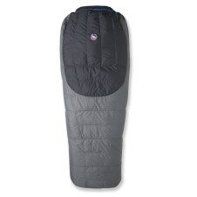
Shapes: Semi-Rectangular Sleeping Bags
These models are narrow at the feet, broad at the hips and shoulders. You get more space than a mummy supplies, but also more weight and bulk. Some offer hoods.
Positives: Good heat retention and a little more room to maneuver.
Negatives: More room means your body has more space to keep warm; some thrashers still find them restrictive.

Slide 15
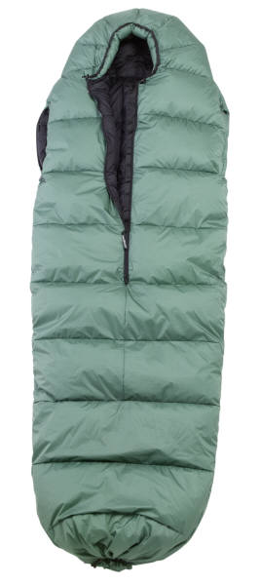
Shapes: Mummies Sleeping Bags
These narrow, close-fitting bags are designed to save weight and maximize heat retention. They start narrow at the feet, get wider toward the shoulder, then taper to an insulated, fitted hood. Nearly all backpacking bags are mummy-shaped.
Positives: The slim cut increases efficiency and saves space and weight. Hoods retain a lot of warmth.
Negatives: The narrow shape can feel restrictive to some people and inhibit sleep.

Slide 16
Size of Sleeping Bags
Here's the general rule: If you are under 5 feet tall choose a kids size bag. If you are between 5 feet and 6 feet, choose a regular length bag. If you are up to 6-feet-6, you want a long bag.
If you are right on the border, maybe right at 6 feet or maybe half an inch taller, it's a judgement call on your part. If you choose a bag that's too short, you might tend to stretch a bag to make it cover you. Doing so flattens the bag (and its insulation) in spots, reducing its effectiveness. Sleeping in a bag that's too long means your feet have lots of space to heat up. Solution: Buy the longer bag and tie off the extra length of the bag with some cord.

Slide 17
Shell Fabrics
Typically, sleeping bag shells are made with one of the following fabrics:
DryLoft®: From the makers of Gore-Tex®, this nylon with a water-resistant/breathable membrane is the shell of choice for down sleeping bags used in wet conditions. It can withstand light rain, but not a downpour.
Taffeta: A light, smooth, almost silky style of nylon. Cozy and touchable.
Ripstop: Similar in weight and feel to taffeta, but it is reinforced with tiny ribs of material, creating a checkerboard-like pattern. Stronger, but not as luxurious to the feel.

Slide 18
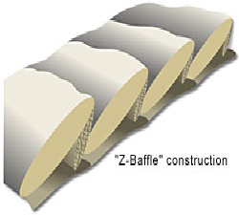
Sleeping bag Construction
Baffles
Every sleeping bag has a shell (the outer layer) and a liner (the inner layer that touches your skin). In between is the insulation, and the even distribution of that insulation depends on how it is held in place. In better-quality down bags this is done through the use of baffles. In above-average synthetic bags, either shingled construction or offset-quilted layers are used.

Slide 19
Insulation: Down or Synthetic?
The insulation or "fill" inside a sleeping bag largely determines a sleeping bag's:
Weight (and thus its "warmth-for-weight" ratio)
Compressibility
Durability

Slide 20
Down: Down is the wispy, fluffy undercoating found just beneath the outer feathers of geese and ducks. This natural fiber is an extraordinary insulator. Goose down is preferred to down from ducks, prized because it is believed its plumes offer a higher "fillpower"
Down's positives include:
It offers tremendous warmth for surprisingly little weight (thus offering a superior "warmth-to-weight" ratio).
It can be compacted into very small sizes.
Its effectiveness outperforms synthetic insulation by years—even decades.
Down, though, does have a downside:
If it gets wet, it is of no value until it dries—and in the field, that can take a long time.
It is more expensive (keep in mind, though, that its resistance to deterioration makes it an outstanding long-term value).

Slide 21
Synthetic Materials: Synthetic materials are basically plastic threads (extruded polymers, to be technical). The threads are most commonly a continuous filament (a long, single strand). They can also be arranged in short "staples" up to four inches long. Usually the threads are hollow, reducing their weight and enabling them to trap more air.
The advantages of synthetic fill include:
It still provides some insulation when wet; plus it dries fairly quickly.
It's less expensive than down.
It's non-allergenic.
The shortcomings of synthetic fill are:
It's bulkier than down (so it takes up more space when you're carrying it).
It's heavier (it takes more weight to get the same warmth down provides).
The filaments gradually degrade over time.
The insulating "batts" of filaments are stiffer than down and do not drape over the contours of your body as effectively.

Slide 22
Comfort Rating
A sleeping bag's temperature or "comfort" rating identifies the most extreme temperature the bag is designed to accommodate. When you hear a bag described as a "+20 bag," it suggests most users should remain comfortable if the air temperature drops no lower than 20 degrees Fahrenheit.
Bag Type | Comfort Rating (°F)
Summer Season | +35° and higher
3-Season Bag | +10° to +35°
Cold Weather | -10° to +10°
Winter/Extreme | -10° and lower

Slide 23
Personal Sleeping Tendencies
Humans all have different metabolic rates, and no industry standards exist that uniformly determine sleeping bag comfort ratings. Instead, each manufacturer assigns a rating to its bags based on its own research. Therefore, use their rating as a guide, not a guarantee. If you have trouble deciding between two bags, it's not a bad idea to select one that offers a little more warmth than you think you might need. Many factors affect your ability to keep warm inside a sleeping bag:
The insulating pad beneath your bag.
The presence/absence of a tent.
Your metabolism; you might be a "cold sleeper".
Your gender.
Clothing worn while inside the bag.
Adjustments you make while in the bag.
Food in your stomach.
Hydration

Slide 24


Tents and Shelters
All your tent does is keep you sheltered from rain, wind, sun and bugs- that’s not too important!

Slide 25
Type of Tents
Tarp Tents: Simplest of all tents. Has no floor.
A-frame Tent: Has lots of headroom, but does not do well in heavy winds or snow.
Dome Tents: Most common tent and free standing design.
Bivy Sack Tent: Waterproof barrier for your sleeping bag. Can feel confining.

Slide 26
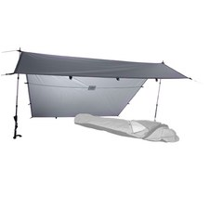
Tarp Tents: Simplest of all tents. Has no floor.

Slide 27
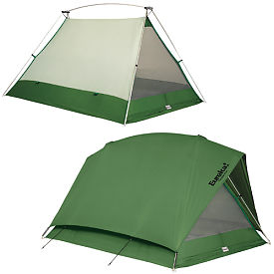
A-frame Tent: Has lots of headroom, but does not do well in heavy winds or snow.

Slide 28
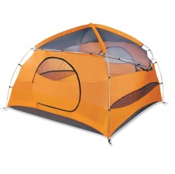
Dome Tents: Most common tent and free standing design.

Slide 29
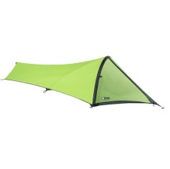
Bivy Sack Tent: Waterproof barrier for your sleeping bag. Can feel confining.

Slide 30
Guyout Loops: Higher-quality tents will include loops on the outside of the tent body for attaching guy lines. Guy lines allow you to batten down the hatches during high winds.
When high winds or a storm are predicted, do not count on staking alone to keep your tent secure. Depending on the model, your tent fly has built-in loops or rings at optimal guyout locations. It's important to put in the extra time guying out your tent. Correctly done, it can save your tent during harsh weather.
Attach parachute cord to the loops/rings and stake them in the ground three or four feet from the edge of the tent. If staked too close to the tent, wind can cause an upward pull that could dislodge the stakes.
If your tent does not have loops or rings for guyouts, attach guylines 1/3 or 1/2 of the way up the framework on the main sidewalls. This enables the guyline to support the lower section of the pole, while the upper pole can flex the side of the guyout. This will prevent all movement except toward the the anchor. The idea is to get the guylines to work together through opposition.

Slide 31
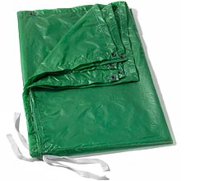
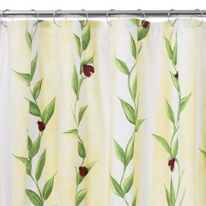
Ground Cloths
Acts as a moisture barrier
Helps insulate
Protects your tent or sleeping bag

Slide 32
Pads and Mattresses
Air mattresses
Open-cell foam pads
Closed-cell foam pads
Self-inflating pads

Slide 33
Air mattresses
Air mattresses- basic, inflatable air bladders
Positives- They're comfortable, adjustable and inexpensive.
Negatives- They tend to be heavy, bulky and they can be punctured/ripped easily. Air inside is free to circulate, so they tend to be poor insulators.

Slide 34
Open-cell foam pads
Open-cell foam pads- sponge-like foam pads made up of tiny, open air cells
Positives- They're comfortable, lightweight and inexpensive. The tiny foam cells restrict air circulation, so they are also more effective insulators than air mattresses.
Negatives- Open-cell foam is absorbent, which can cause problems in wet conditions. It's also less insulating than closed-cell foam (it must be cut about four times as thick to get the same insulation). Open-cell foam tends to be bulky, difficult to compress (for packing) and not very durable.

Slide 35
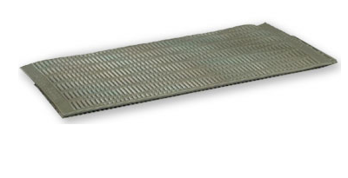
Closed-cell foam pads
Closed-cell foam pads- pads made out of dense foam filled with tiny closed air cells
Positives- They're cheap, durable (won't pop when tromped on) and extremely insulative (almost no circulation of air in pad, so they can be cut thin yet still provide good insulation). Closed-cell foam is also non-absorbent.
Negatives- They're relatively stiff and firm, with far less cushioning than open-cell foam (so you'll need a thicker, heavier piece to be as comfortable).

Slide 36
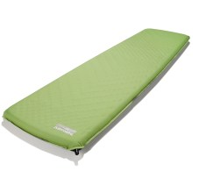
Self-inflating pads
Self-inflating pads- open-cell foam pads wrapped in air-tight, waterproof nylon shells.
Positives- They're as comfortable as open-cell foam, but much more insulating (the nylon shell limits air circulation, while also protecting against water absorption). They're adjustable (built-in air valves let you control the amount of air inside and thus the firmness of the pad) and they're extremely compact when rolled up.
Negatives- They're more expensive than the options listed above. Can be punctured or ripped (though field repairs are not difficult). Heavier than open- or closed-cell pads.

Slide 37
Overnight Gear
Rain Gear
Warm Jacket/Sweatshirt
Cup, Bowl, Knife & Fork/Spoon
Insect Repellent
Extra Clothing
Toothpaste, Toothbrush, Soap, Washcloth, towel & comb
Change of clothes
Durable Shoes
Hat or Cap

Slide 38
Optional Items
Camera
Binoculars
Sunglasses
Notebook and pencil
Nature Books
Swimsuit, Bath Towel
Fishing Gear

Slide 39
Campsite Consideration
Location
Size and Shape
Protection
Insects and Animals
Ground Cover
Drainage
Privacy
Beauty
Tread Lightly

Slide 40
Pack/Group Gear
First Aid Kit
Food
Cooking utensils
Stove and fuel or Firewood or charcoal and cooking grate
Matches and/or fire starters
Aluminum foil
Biodegradable soap
Sanitizing agent
Plastic scouring pad, dish mop, wash tubs
One hundred feet of rope
Water containers
Trash bags
Paper towels

Slide 41
Pack/Group Gear
U.S. Flag
Pack Flag
Repair Kit (rubber bands, safety pins, sewing gear)
Toilet paper
Shovel
Cooler
Activity gear (game material, craft supplies, etc)

Slide 42
Spare Gear
Tents stakes
Fuel canisters
Ground cloth or tarp
Insect repellent
Sunscreen
Eating utensils
Blanket

Slide 43
Nice-To-have Group Gear
Marshmallows, Popcorn, etc.
Dutch Oven
Cooking fly or tarp
Musical instruments
Lawn chairs, camp stool

Slide 44
Locating Equipment
Boy Scout Troops
Friends who camp
Stores that rent camping equipment
Army Surplus Stores
Online-eBay

